Slide 1


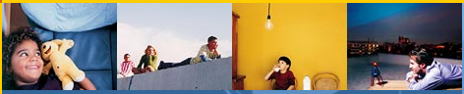
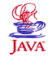
J2ME on Terminal Device with Service Discovery Protocol
นายขจร เจียรนัยพานิชย์ 42010033
นางสาวจริยาพร บุญสังข์ 42010046
Advisor
ผศ.อภิเนตร อูนากูล
อ.ดุสิต นิยะโต

Slide 2

Agenda
Project Background
Objectives
Goals
Project Scope
Project Architecture
Com86 Board
J2ME Technology
Jini Technology
Project Plan

Slide 3
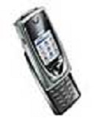



Project Background
J2ME
Application
Write once run Anywhere

Slide 4


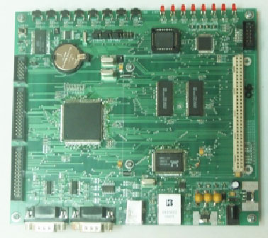

Project Background
J2ME
Application
Com86 Board

Slide 5
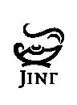
Objective
I can run
Java Application
Com86 Board

Slide 6



Managing Ubiquitous
Device Framework
- Embedded J2ME on Terminal Device
-Embedded Web service on Terminal Device
-Terminal Device
Device Management Station
Wireless Router
Device
16 Bit Device
Management Station
Network
PC based

Slide 7
Goals
1. Com86 Board can run Java Application
2. Com86 Board have Jini Technology
3. Jini Network (Service Discovery Protocol)

Slide 8
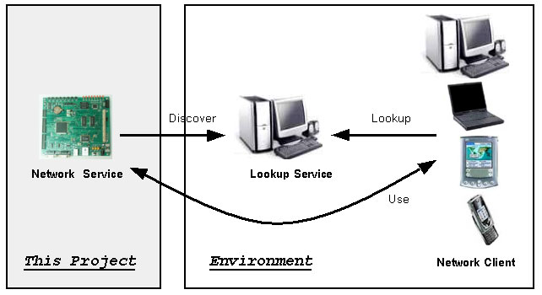
Project Scope

Slide 9
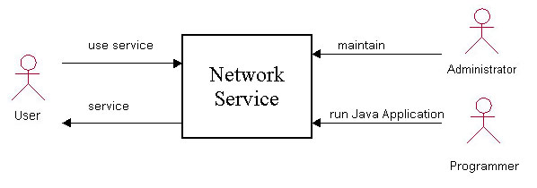
Context Diagram

Slide 10
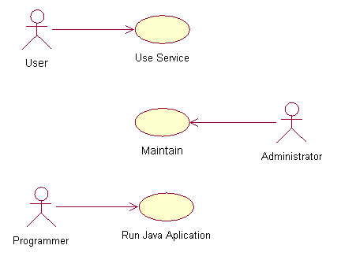
Use Case Diagram

Slide 11
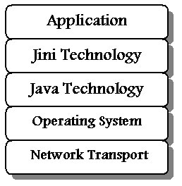
Project Architecture

Slide 12
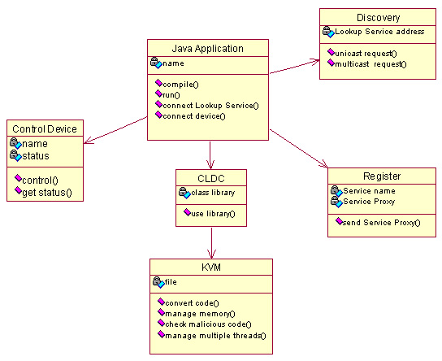
Class Diagram

Slide 13
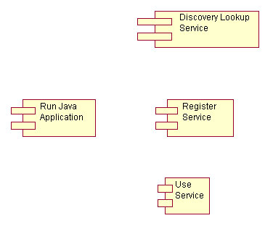
Component Diagram

Slide 14
J2ME

Slide 15
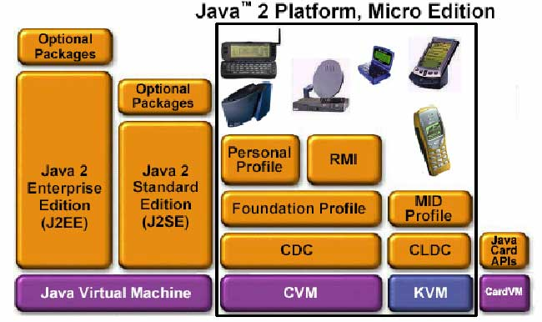
J2ME
This Project

Slide 16
KVM
What is KVM ?
A small footprint Java virtual machine
Few hundred kilobytes of total memory
Static size of VM executable: 40- 80 kB
16-32 bit processor
Implemented in C code

Slide 17
KVM Achitecture
VmCommon
VmExtra
KVM
VmPort
VmWin
VmUnix
VmPalm

Slide 18
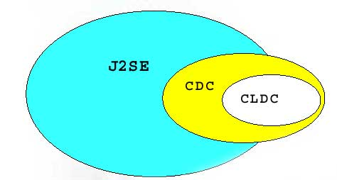
CLDC
What is CLDC ?
Connected Limited Device Configuration
Subset of Java features
For limited devices
Processor: 16 or 32- bit
160 - 512 KB of memory

Slide 19
CLDC Architecture
CLDC Packages
    Inherited from J2SE
      java.lang
      java.io
      java.util
    Specific to CLDC
      javax.microedition.io

Slide 20
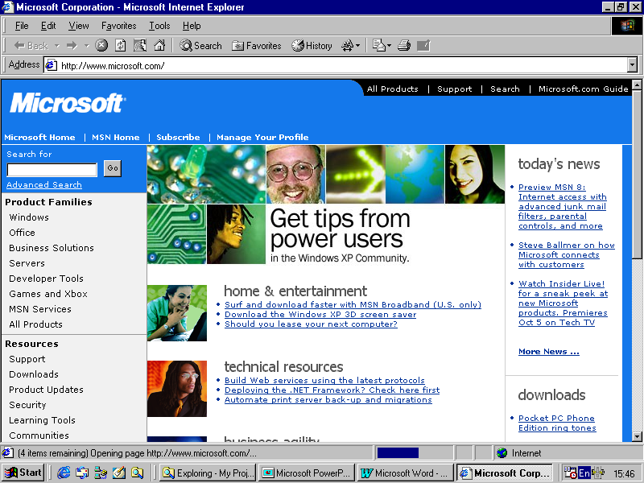
Com86 Board

Slide 21
Com86 Board
- Micro Controller Am186CC 25 MHz
- Main Memory 1 MBytes
- Boot Memory 64 KBytes
- Ethernet with 10BaseT
- USB (USB Device)
- Storage 512 Kbytes ( can be extension)

Slide 22
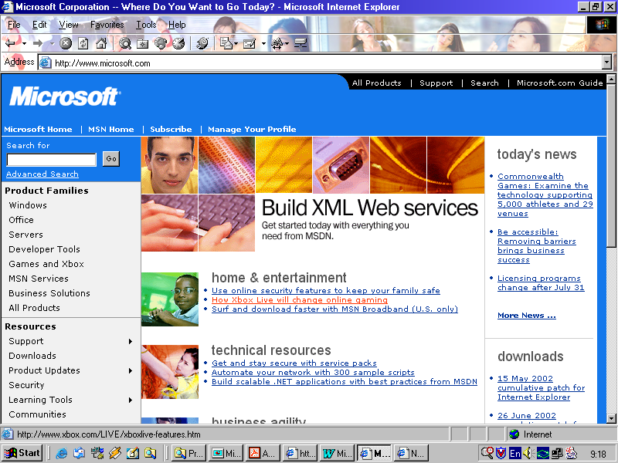
JINI

Slide 23
JiniTM Technology
Distributed Computing
Distributed Object
Network Plug and Play
Not configuration
Automatic change themself
Working with unknow service

Slide 24
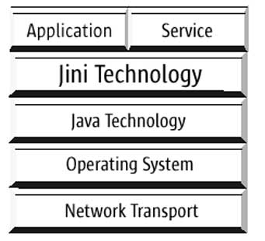
Jini Architecture

Slide 25
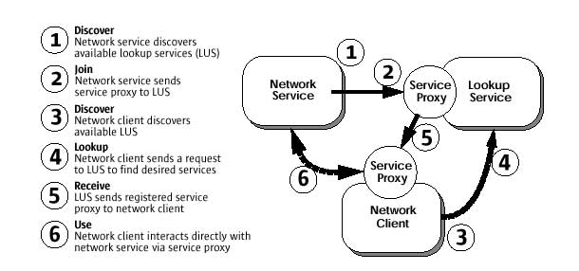
Jini Lookup Service
1
2
Network
Service
Lookup
Service
Service
Proxy
5
4
6
Service
Proxy
Network
Client
3

Slide 26
Project Plan
Project 1
- Search and Learning J2ME
- Search and Learning Com86 Board
- Search and Learning Jini
- Reverse Engineering KVM
- Reverse Engineering CLDC
- Learn how to porting KVM on Com86 Board

Slide 27
Project Plan
Project 2
- Porting KVM to Com86 Board
- Reverse Engineering Jini
- Porting CLDC and Jini on Com86 Board
- Setup Jini Network
- Test Com86 Board and Jini Network
- Document

Slide 28
Questions are welcome…..

Slide 29
Thanks You

